Slide 1
Important Instructions
All must ensure that they are designing and developing their project by themselves
Do not Copy-paste Text from your FYP Proposal, rather type in your own simple words
Use Same Font-Style and Font-Size throughout the slides
Use minimum Text in Slides (Add only main points in slide & explain verbally during presentations)
Use suitable images/visuals on slides as per need
Deliver your presentation in English, for this you are advised to practice as much as possible
Dress Well when you come for your presentation
If you are developing the project in Group, then all the members divide the slides and explain their selected slides on their turn in front of examiners
Remember FYP is nothing, but is an effort and the final chance for you to prepare yourself to appear well ,when you go for a Professional Interview in your future ahead- Saif

Slide 2


Slide 3


IOT Based Smart Animal Market With Tracking App
PMAS-Arid Agriculture University- Rawalpindi University Institute of Information Technology
Shahzad Hussain 18-ARID-2929
Sameer Akhter 18-ARID-2924
Shahab Ahmad 18-ARID-2927
Supervisor : Mr: Zeeshan Javed

Slide 4

Contents
Introduction
Existing System
Problem Statement
Problem Solution
Project Scope
Project Objective
Diagrams - Use case, Class, Sequence, Component, Activity, Deployment
Tools and Technologies
Task Distribution
Screenshots
Future Project Schedule
University Institute of Information Technology, PMAS-Arid Agriculture University- Rawalpindi

Slide 5
Introduction
In today's world people are not taking care of animals as they do for humans, the whole world is busy in caring for their living, therefore for the sake of benefit and best care of animals we are developing an app so that everyone can take care of their animals easily and can buy animals stuff online without visiting any shop or store as they can buy animal stuff online through this application.
University Institute of Information Technology, PMAS-Arid Agriculture University- Rawalpindi

Slide 6
Existing System
There are only few apps in market which are giving such facility and features. Screen shots are attached as follows.
Pets for Sale- Animals, Puppies, Dogs for Sale which used to sell and buy animals, puppies, and dogs etc. It has a quit negative feedback because worst as quoted by different user in the review section. This app is worst when I click for puppies of dog or animal it says application unavailable I hope it works please, I want to buy puppies. And it not include any tracking facility.
You can see other apps are giving only purchase of few animals and their reviews are not very good other than that we are providing many more features like “Selling and purchasing, Veterinary appointment, Butcher services, Tracking system, Delivery and improving list of animals which can be sold or purchased and providing a tracking system with each pet so that their animal will never be lost. We are giving a animal doctor veterinary features as well.
University Institute of Information Technology, PMAS-Arid Agriculture University- Rawalpindi

Slide 7
Problem Statement
Most of the houses has a pet animal in their house. Along with animals there are a lot of responsibilities such as their food, medicines and other daily life stuff. For this reason, animal owner has to visit store, vent and other shops. It takes more than ten minutes even if we go out to have a small item. Keeping all these things in our mind we are going to develop an application for every person who wants to save his/her physical energy and time. We are creating a best solution for you which is “smart pet vet” so you can get whatever grocery item you need on a single click on mobile phone. We will implement tracker system in every pet/animal so that we can track each and every animal.
University Institute of Information Technology, PMAS-Arid Agriculture University- Rawalpindi

Slide 8
Proposed Solution
This project will have a value in market because it includes the services which are one of their kinds to help in saving time and physical energy. We are mainly targeting the houses that have pet with them.
University Institute of Information Technology, PMAS-Arid Agriculture University- Rawalpindi

Slide 9
Project Scope
We are going to develop an application which can be used everywhere. Every place which involves human beings can use this application as it will provide each and every item of animal grocery which can be used by anyone and track animal.
University Institute of Information Technology, PMAS-Arid Agriculture University- Rawalpindi

Slide 10
Project Objectives
The objectives of this application are to save time and money. This application would help in giving you whatever food items, medicines, doctor facility, butcher and tracking of animals on a single click. User can use facilities that are described above easily instead of going to stores.
University Institute of Information Technology, PMAS-Arid Agriculture University- Rawalpindi

Slide 11
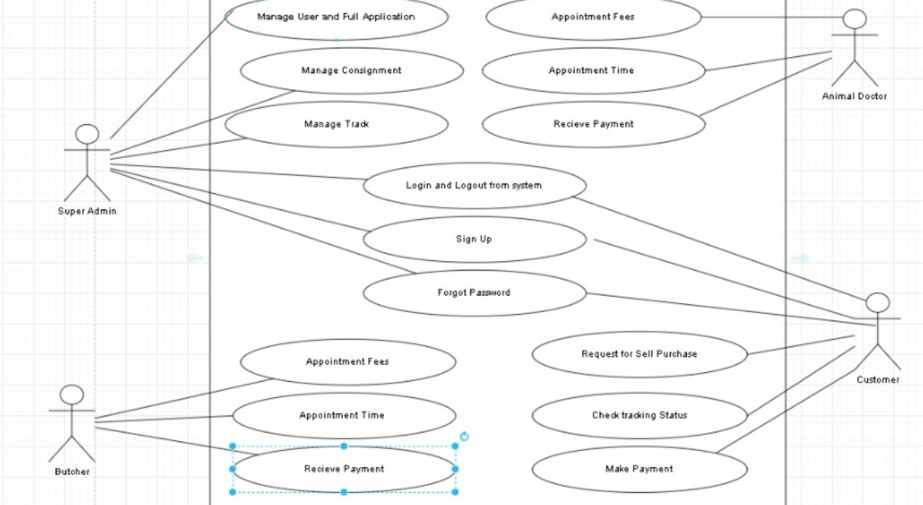
Diagrams –Class Diagram
University Institute of Information Technology, PMAS-Arid Agriculture University- Rawalpindi

Slide 12
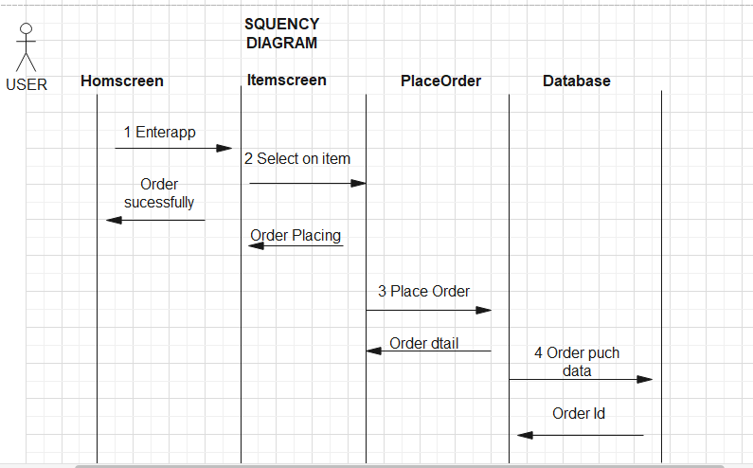
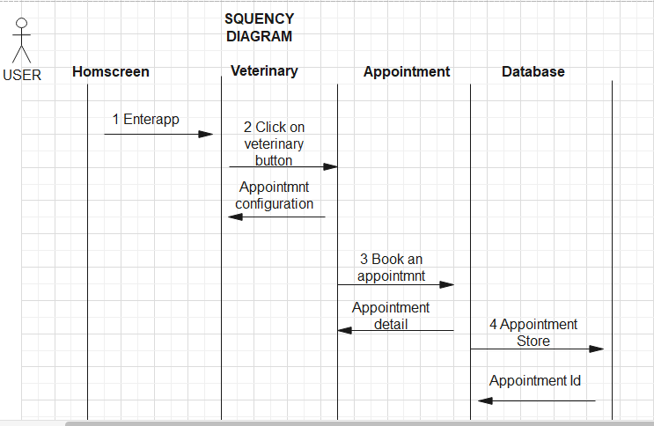
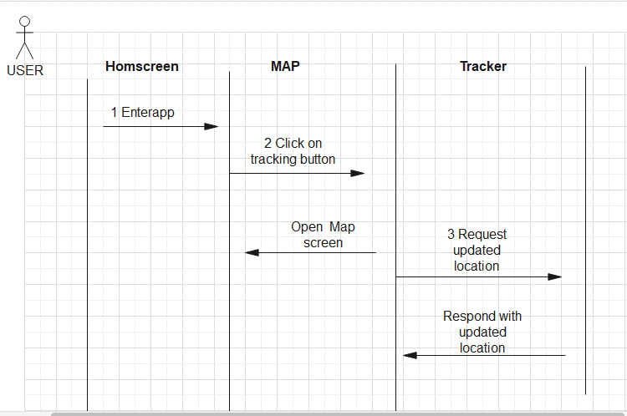
Diagrams –Sequence Diagram
University Institute of Information Technology, PMAS-Arid Agriculture University- Rawalpindi

Slide 13
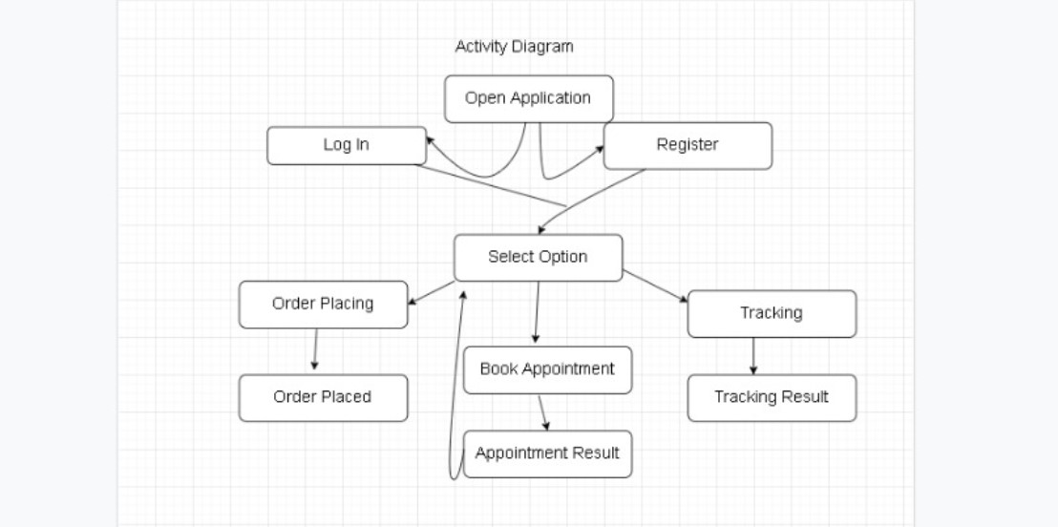
Diagrams –
University Institute of Information Technology, PMAS-Arid Agriculture University- Rawalpindi

Slide 14
Tasks Distribution
Group Members | Responsibilities
Sameer Akhter | Creating Database, Defining Tables in Database Designing Interfaces- Designing and Coding Documentation
Shahzad Hussain | Designing Interfaces- Designing Template/Master Page Coding-front page interfaces Documentation
Shahab Ahmad | Presentation Designing Interfaces- SignUp Form and SignIn Form Documentation
University Institute of Information Technology, PMAS-Arid Agriculture University- Rawalpindi

Slide 15




Tools & Technologies
University Institute of Information Technology, PMAS-Arid Agriculture University- Rawalpindi

Slide 16
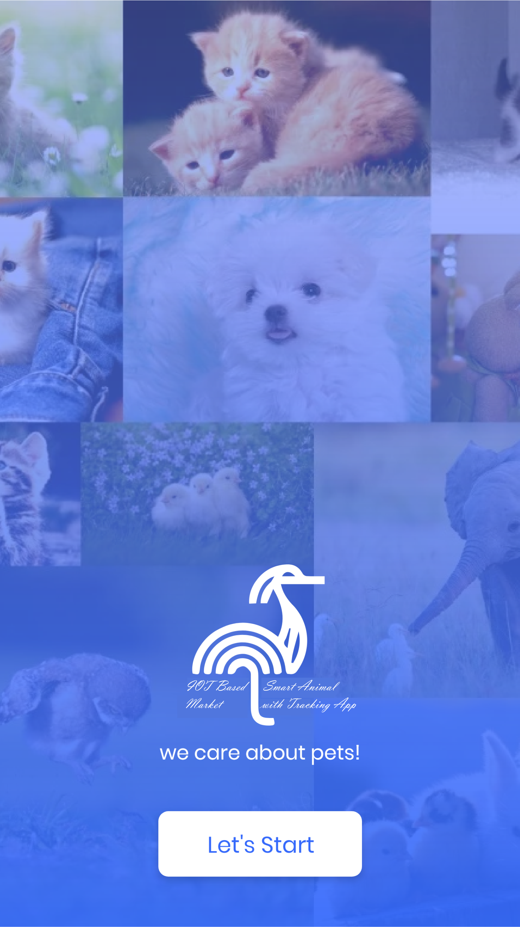
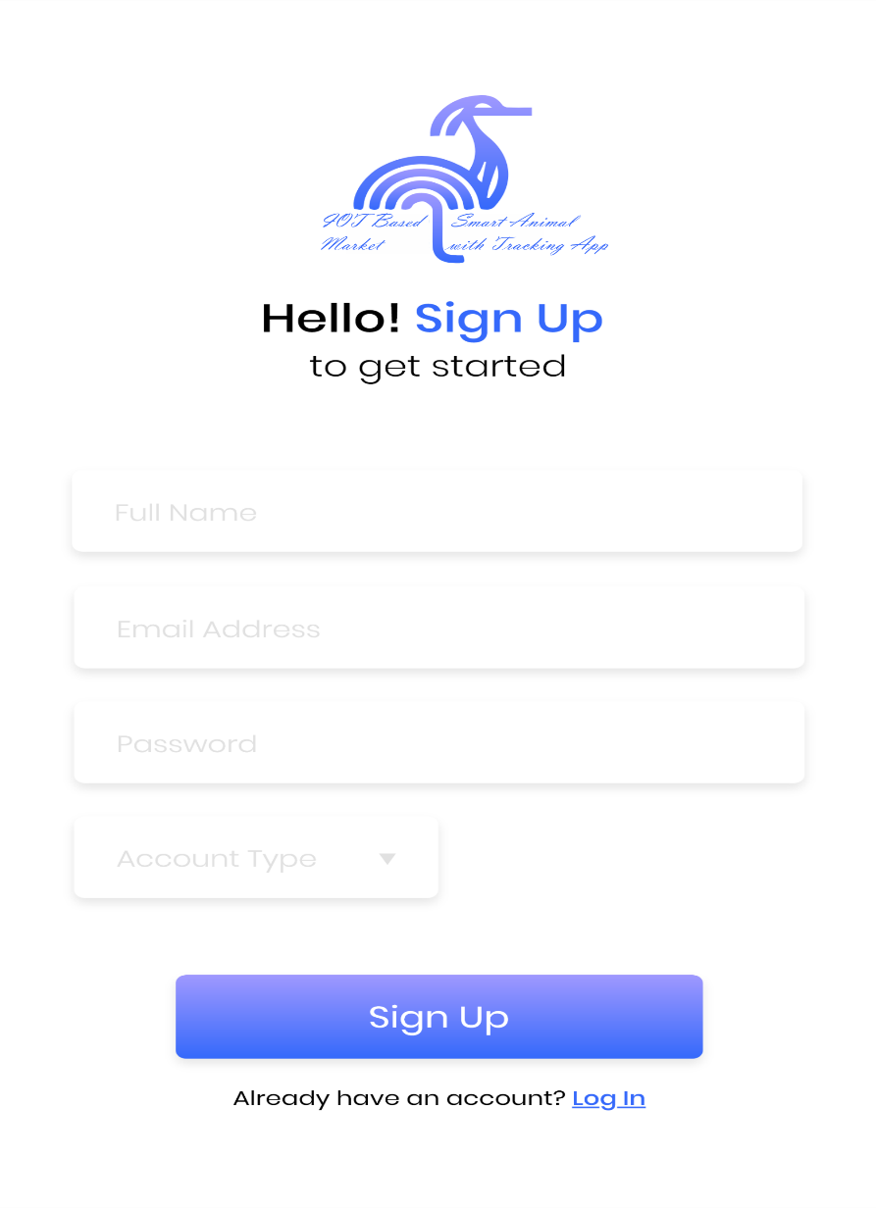
Screen Shots
University Institute of Information Technology, PMAS-Arid Agriculture University- Rawalpindi

Slide 17
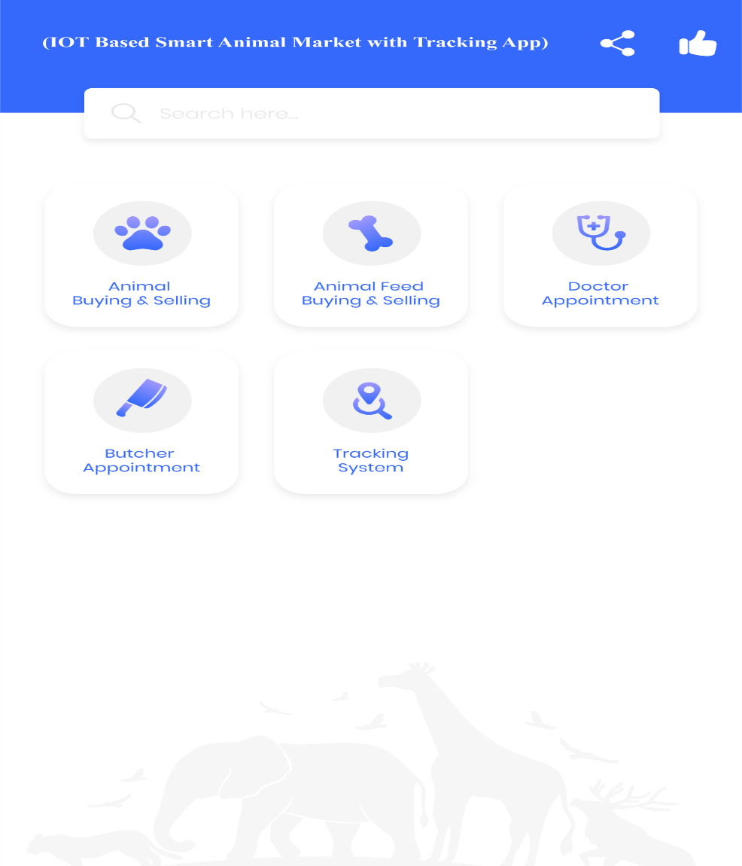
Screen Shots
University Institute of Information Technology, PMAS-Arid Agriculture University- Rawalpindi

Slide 18
Future Project Schedule
Tasks | Schedule
Design & Coding of Project Manage Vehicles Manage Driver Details Manage Feedback, Session, Gallery Pages & other Pages | 25th November To 30th December 2021
Creating Reports | 1st January to 15th January 2022
Testing of Project Module wise & Finishing the Code | 16th January To 30th February 2022
Integrating Project | 1st May 2022 To 20th May 2022
Testing of Project | 21st May To Finish Date
University Institute of Information Technology, PMAS-Arid Agriculture University- Rawalpindi

Slide 19


